Slide 1
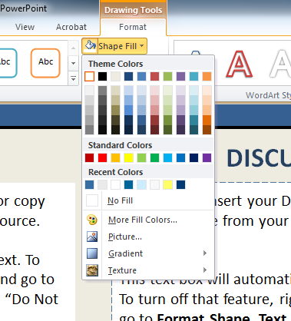
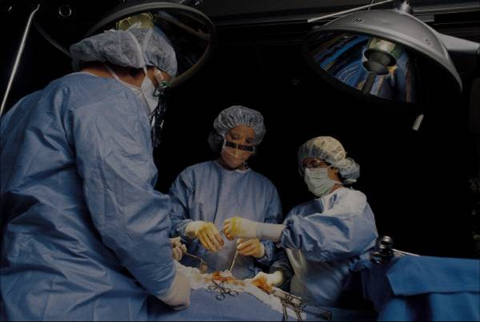
Replace This Text With Your Title
Luigi Piceci, MD¹; Anna Maria Mariani, PhD²; Stefania Morsanuto, MD, PhD^{1,2}
¹Cusano University, ^{2xxxxxxxx}
3° International Conference
ABSTRACT
INTRODUCTION
RESULTS
DISCUSSION
Click here to insert your Abstract text. Type it in or copy and paste from your Word document or other source.
This text box will automatically re-size to your text. To turn off that feature, right click inside this box and go to Format Shape, Text Box, Autofit, and select the “Do Not Autofit” radio button.
has provided this template to assist in preparation of a medical or scientific research poster. The dimensions are set to 24” high by 36” wide but prints can be scaled up or down in size to any dimension with a 2:3 aspect ratio. For example, if you order a 36” x 54” poster using this template, we will print the file at 150% of its original size. The most critical factor is that your template and poster dimensions must be proportional:
$$\frac{template height}{template width} = \frac{desired print height}{desired print width}$$
Xxxxxxxxxx
.
Click here to insert your Results text. Type it in or copy and paste from your Word document or other source.
This text box will automatically re-size to your text. To turn off that feature, right click inside this box and go to Format Shape, Text Box, Autofit, and select the “Do Not Autofit” radio button.
To change the font style of this text box: Click on the border once to highlight the entire text box, then select a different font or font size that suits you. This text is Calibri 22pt and is easily read up to 4 feet away on a 24x36 poster.
Zoom out to 100% to preview what this will look like on your printed poster.
Speaking of Results, yours will look better if you remember to run a spell-check on your poster! After you’ve added your content click on Review, Spelling, or press F7.
Click here to insert your Discussion text. Type it in or copy and paste from your Word document or other source.
This text box will automatically re-size to your text. To turn off that feature, right click inside this box and go to Format Shape, Text Box, Autofit, and select the “Do Not Autofit” radio button.
To change the background color of any text box, click once on the box so it is outlined with a dashed border. Then select Shape Fill from the Drawing Tools, Format tab on the ribbon bar above. It’s the one with the ‘paint can’ icon.
Table 1. Label in 20pt Calibri.
 | Heading | Heading | Heading
Item | 800 | 790 | 4001
Item | 356 | 856 | 290
Item | 228 | 134 | 238
Item | 954 | 875 | 976
Item | 324 | 325 | 301
Item | 199 | 137 | 186
METHODS AND MATERIALS
Click here to insert your Methods and Materials text. Type it in or copy and paste from your Word document or other source.
This text box will automatically re-size to your text. To turn off that feature, right click inside this box and go to Format Shape, Text Box, Autofit, and select the “Do Not Autofit” radio button.
To change the font style of this text box: Click on the border once to highlight the entire text box, then select a different font or font size that suits you. This text is Calibri 22pt and is easily read up to 4 feet away on a 24x36 poster.
CONCLUSIONS
Click here to insert your Conclusions text. Type it in or copy and paste from your Word document or other source.
To change the font style of this text box: Click on the border once to highlight the entire text box, then select a different font or font size that suits you. This text is Calibri 22pt and is easily read up to 4 feet away on a 24x36 poster.
Zoom out to 100% to preview what this will look like on your printed poster.
CONTACT
REFERENCES
<your name>
<your organization>
Email:
Click here to insert your References. Type it in or copy and paste from your Word document or other source.
Click on the border once to highlight and select a different font or font size that suits you. This text is in Calibri 20pt and is easily readable up to 3 feet away.
Figure 1. Label in 20pt Calibri.
Figure 2. Label in 20pt Calibri.
Chart 1. Label in 20pt Calibri.

